Slide 2
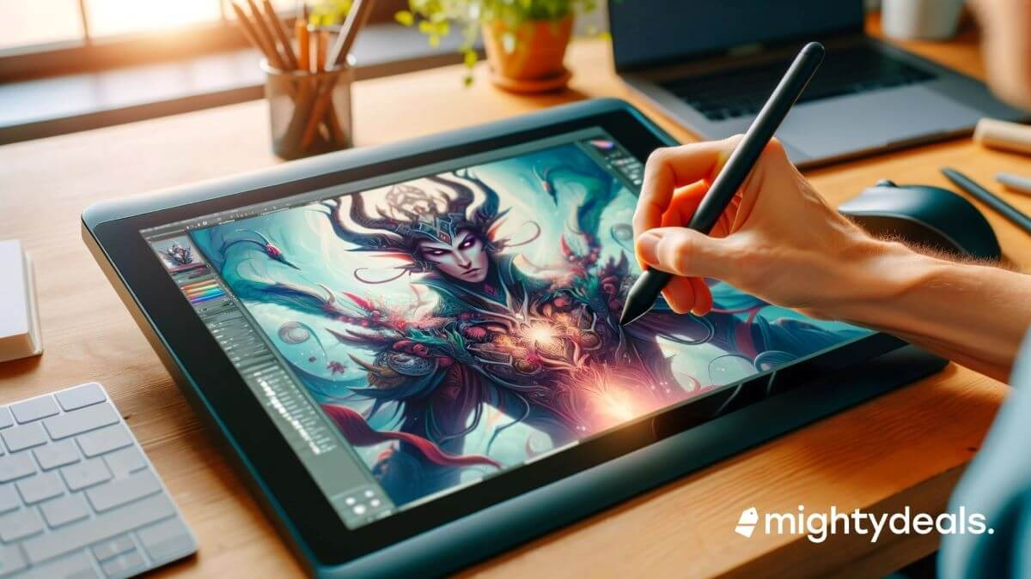
MEDIA AND
ENTERTAINMEMNT

Slide 3
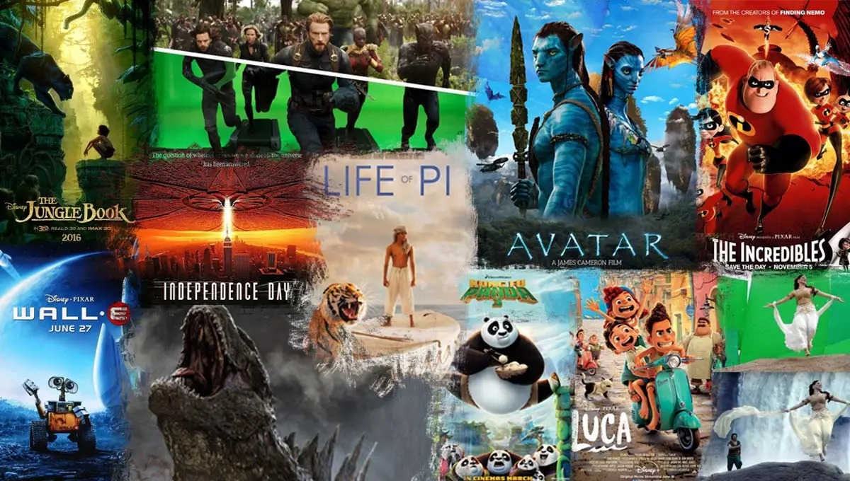
In the 2D animation industry there are mainly two styles –
SKELETAL and
TRADITIONAL

Slide 4

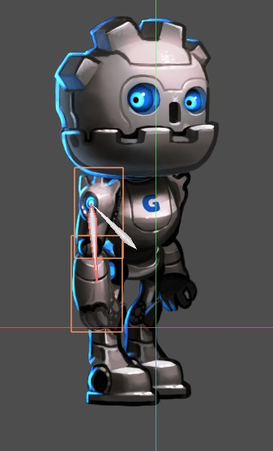
Skeletal animation is when a character's movement is controlled by an invisible skeleton inside it. Think of it like a puppet: the skeleton moves the puppet's limbs, and the outer skin follows the bones.
These bones are linked to a mesh (the character’s outer body), and when the bones move, the mesh moves with them, creating lifelike animations. However, it does have some creative limits.

Slide 5

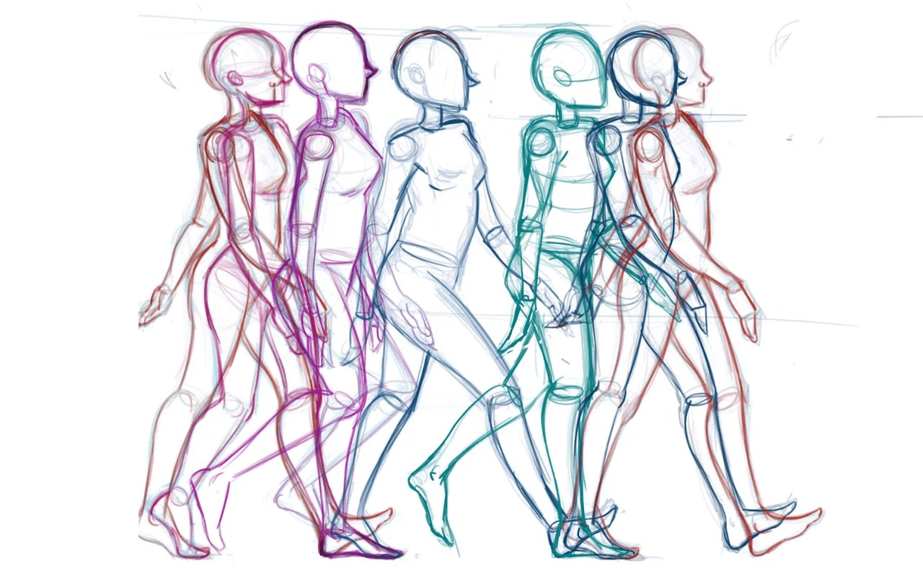
Traditional animation is the process of creating movement by drawing each frame by hand. Each drawing is slightly different from the last, and when played quickly, they create the illusion of smooth motion.
It’s like flipping through a sketchbook and watching the pictures come to life. The disadvantage of traditional animation is that it’s time-consuming and labor-intensive, requiring many hand-drawn frames for each movement.

Slide 6
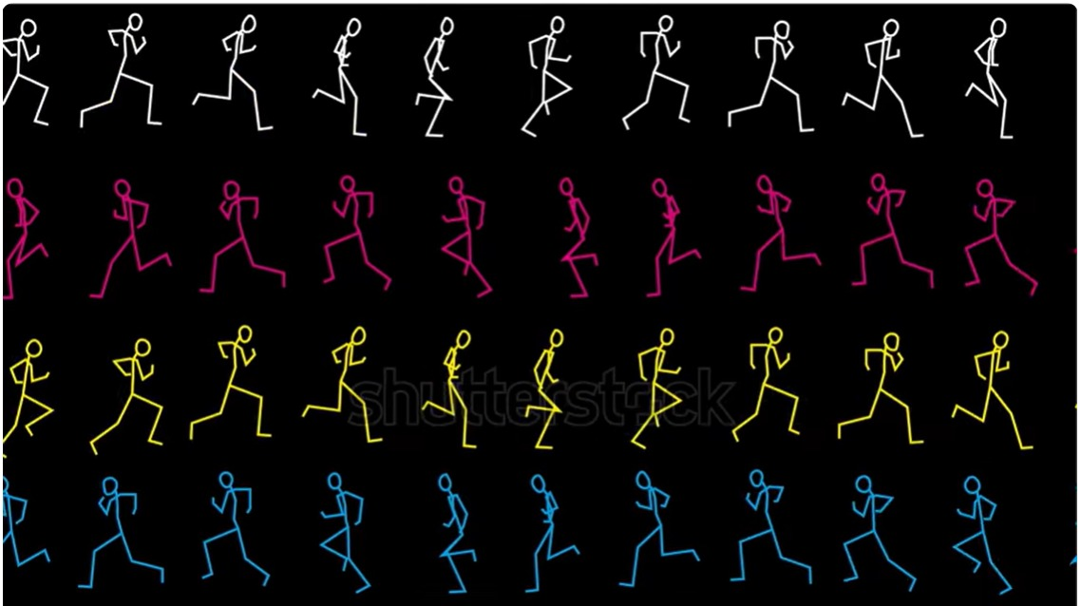
Our Solution :-
SkelTra
Bring your creativity to life !!
with the perfect blend of classic hand-drawn charm and smooth skeletal animation..

Slide 7
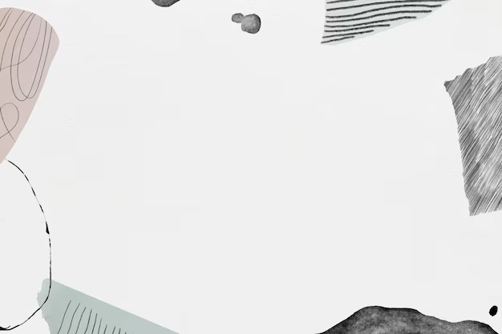
- Our idea is to create software which provides animators to create character animations by blending traditional animation style into skeletal animation where it is needed.
- This will overcome the creative limit of skeletal animation and also reduce the number of frames needed to be drawn if we use traditional style.
- The software will also provide a way to animate the character in the animation from different camera views.

Slide 8

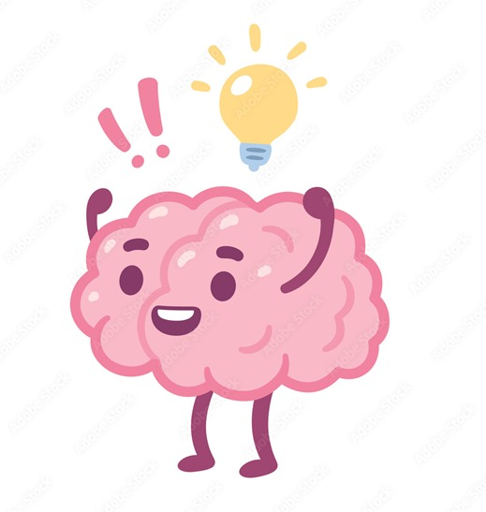
HOW I CAME UP WITH THIS IDEA ?
Two years ago, I was working on a 2D side-scroller game that required character animations. Since I didn't have an artistic background, I couldn't rely on traditional animation techniques. As a result, I turned to skeletal animation.
However, there was a challenge: the game required the character to rotate and perform various fighting moves, which wasn’t possible with skeletal animation, as it can only display one view at a time
To overcome this limitation, I came up with the idea of dynamically changing frames during the animation runtime to simulate rotation and provide the necessary variety in the character’s movements. And that’s what is the motivation behind this project.

Slide 9
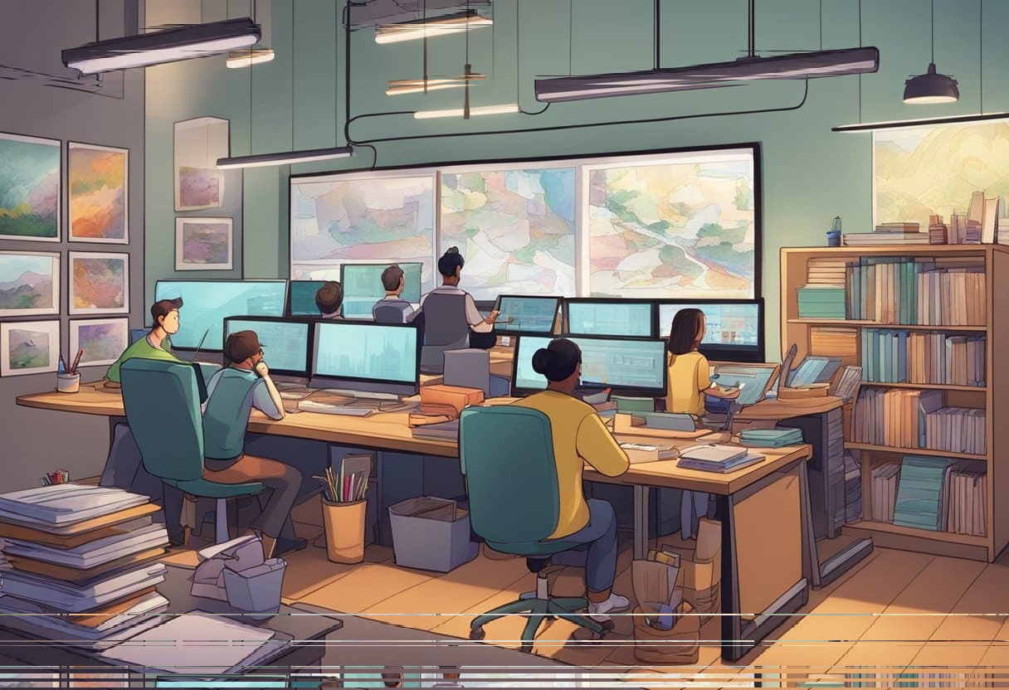
WORKING :
System Setup:
Skeleton Structure: The animation system is based on skeletal animation, where the "base" refers to bones that form the structure of the figure.
Body Parts: The figure is divided into distinct body parts, each associated with a specific bone or set of bones.
Holder Object: A holder object is responsible for containing both the bones (skeletal structure) and the skin (image assets) for each frame.
Animation Process:
Bone Movement: When the bones (skeleton) move, the holder object moves in tandem, which results in the corresponding image (skin) moving as well.
Frame Update: Changing frames involves updating the position and orientation of the bones, which in turn moves the holder and associated image to match the new pose.
Changing Views/Side:
View Update: To show a different view or side of the figure, we switch the image associated with the body parts, while the skeletal structure (bones) remains unchanged. This allows the figure to appear from another perspective without altering its underlying movement or position.
The bones’ movements remain consistent across different views, and only the skin (image) updates to reflect the new view.

